Slide 1
Sickle Cell Disease in Children
Avel eSchool Health
Created by Amanda Allison, RNC 1/2025

Slide 2
What is Sickle Cell Disease (SCD)
A life-long, genetic condition that affects red blood cells. It causes red blood cells to become hard and sickle-shaped, making it hard for them to move through the blood stream. These red blood cells can get stuck leading to pain, infection and other complications.

Slide 3
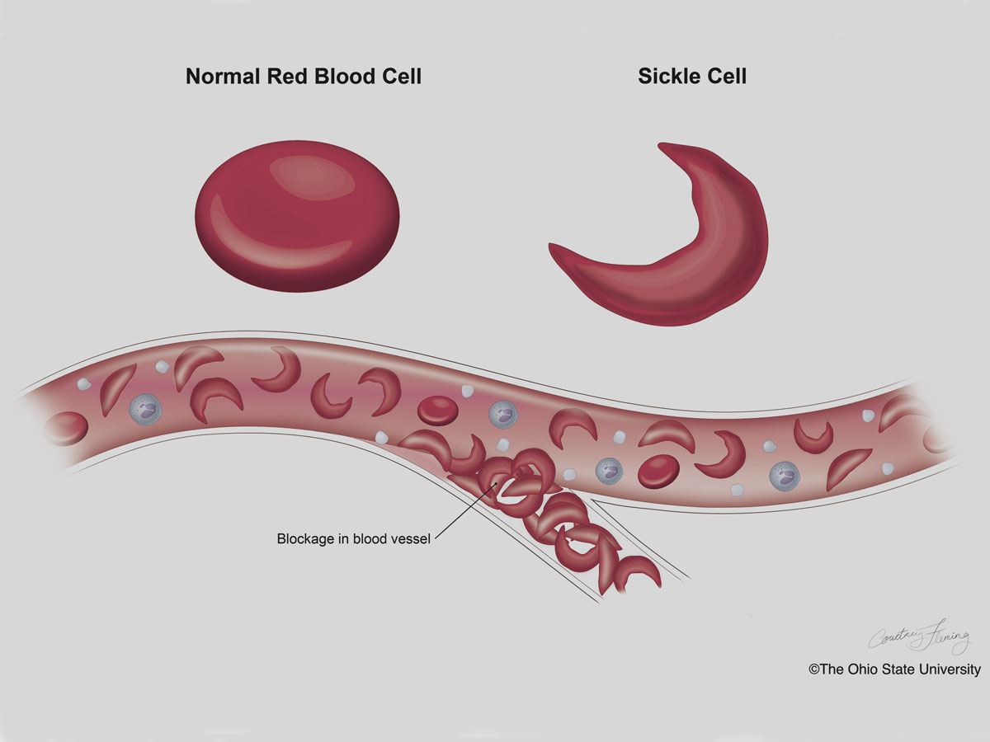
Sickle cells don't carry oxygen well throughout the body which can lead to getting tired easily, slow growth rates, difficulty learning, concentrating and a higher rate of asthma.
© Property of Avel eCare

Slide 4
Staying Safe and Healthy in School
© Property of Avel eCare

Slide 5
Health Considerations
Pain
Sickle cells can stick together and get trapped, causing pain that can be significant, and possibly organ damage.
Check a temperature
Drink water
Administer pain medication, if there is no fever
Use warm packs and massage
Rest
DO NOT APPLY ICE
Notify parent/guardian
Return to class as soon as possible
If pain is not controlled after 2 hours student should go home, consider appointment with provider or ER per parent.
For minor bump, bruises, etc. Utilize elevation, pain medication if needed.
DO NOT USE ICE
Ice can cause constriction of the blood vessels and cause and increase in pain.
© Property of Avel eCare

Slide 6
Health Considerations
Infection
Stroke
Red blood cells can also get trapped in the spleen causing it to enlarge and not function properly, leading to a higher risk for infection.
If the student has a fever over 101 immediately call family who will contact the clinic.
DO NOT give ibuprofen or acetaminophen.
Students take longer to heal, may have more frequent or longer periods of absences.
Due to the clumping of sickled red blood cells students are at an increased risk for stroke.
Call 911 if a student ever displays:
Sudden changes in vision or balance
Inability to move arms or legs normally
Difficulty speaking
© Property of Avel eCare

Slide 7
Health Considerations
Kidneys
Exercise
Sickle cells can also damage kidneys, making it harder for them to concentrate their urine.
Students should be allowed to use the restroom as often as needed.
Expect it will be more frequent than students without SCD.
Exercise is encouraged, with guidelines.
Allow rest as needed
Student should be well hydrated prior and during activity
Allow modification or rest if student is having pain, fatigue or shortness of breath
Fluids
Fluids help keep the sickle cells from clogging small vessels.
Allow students to have water bottles in class and encourage then to drink water.
© Property of Avel eCare

Slide 8
References
Children's Minnesota. Sickle Cell Disease (SCD) A Guide for School Nurses/Educators.
Website: Centers for Disease Control. Article: "Complications of SCD: Splenic Sequestration". https://www.cdc.gov/sickle-cell/complications/splenic-sequestration.html
Website: National Heart, Lung, and Blood Institute. Article: "What Is Sickle Cell Disease?". https://www.nhlbi.nih.gov/health/sickle-cell-disease.

Slide 9
Thank You
Your time is greatly appreciated.
© Property of Avel eCare

