Slide 1
Health Review
All Staff
Reviewed 1/2025 AAllison, RNC

Slide 2
Review
Anaphylaxis
AED
Blood Borne pathogens
Lice
Concussions
Seizures

Slide 3
Anaphylaxis
Anaphylaxis (anaphylactic reaction) is a severe, life-threatening sensitivity to an antigen (unwanted substance).
A medical emergency, signs and symptoms can occur within seconds:
Sweating
Shortness of breath
Low blood pressure
Irregular pulse
Respiratory congestion
Swelling of the larynx (laryngeal edema), lips, face and neck
Hoarseness
Dyspnea

Slide 4
Triggers
Bee stings
Food allergies
Peanuts
Tree Nuts
Eggs
Wheat
Soy
Many, many more

Slide 5
Epinephrine
It quickly constricts blood vessels, raising blood pressure
It relaxes smooth muscles in the lungs to improve breathing
It stimulates the heart beat
Will cause the heart rate to increase
It works to reverse the hives and swelling around the face and lips

Slide 6
When To Give The EpiPen…
Based on student’s symptoms:
Hives spreading over the body
Wheezing, difficulty breathing or swallowing
Swelling in the face, neck, tongue or tingling in the tongue
Vomiting
Signs of shock such as extreme paleness/gray color, clammy skin, loss of consciousness
Any other child specific known symptom
Administer EpiPen
Call 911!
Epinephrine buys you time….
Epinephrine SAVES LIVES!

Slide 7
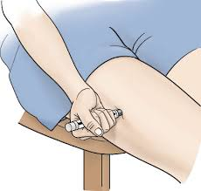
Where Do I Give The EpiPen?
The EpiPen is administered ONLY into the large outer thigh muscles
Can be given through clothing
Give at a 90 degree angle (both sizes)

Slide 8
Video
https://www.youtube.com/watch?v=Ig9rWYYBW8Y

Slide 9
Blood Borne Pathogens
HIV, Hepatits
Gloves
If it is wet, warm and not yours…Don’t touch it!!

Slide 10
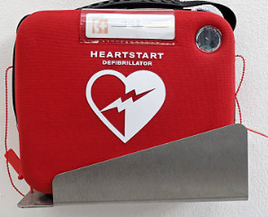
AED (Automatic External Defibrillator)
Video:
https://www.youtube.com/watch?v=BAWGjNAj_vA
911
Where is it kept
Pad placement
Some are fully automatic

Slide 11
Seizures
What is a Seizure?
A neurological condition, usually chronic
Abnormal, excessive electrical discharges from the neurons in the cerebral cortex which may cause loss of consciousness and violent and sudden contractions
Seizures can also be called convulsions
Causes
Fever, head injury, poisoning, genetic condition

Slide 12
Seizure First Aid
Notify office immediately, call eSchool Nurse
Stay calm and track time and type of seizure, what body parts are involved
Keep student safe
Lower to floor if needed
Place soft item under head if needed
Keep airway open and monitor breathing
Do not attempt to restrain or hold them still
Do not put anything in mouth
Other than Dr. ordered emergency medication

Slide 13
Seizure First Aid: After Care
Turn on their side when seizure stops
They may vomit, this will help prevent choking
Stay with student and continually monitor
Breathing, level of consciousness, additional seizure activity, any injury that may have occurred
Give emergency medication as directed, if needed
eSchool nurse will help direct this care and administration
Call 911 as needed
eSchool nurse will help determine if and when this may be needed
Inform parent of all seizures

Slide 14
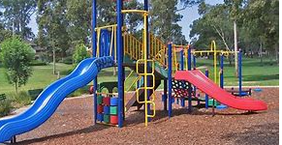
Head Bumps

Slide 15
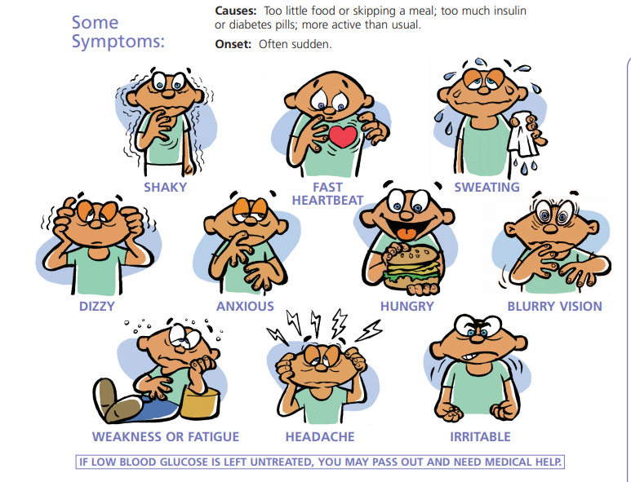
Low Blood Sugar
Check BS
Follow plan
Notify office
Provide juice, snacks

Slide 16
High Blood Sugar
Take to the office if it is a known diabetic
If you notice symptoms in an undiagnosed student notify the nurse or parent

Slide 17
What Is Asthma?
Asthma is a chronic inflammatory lung disease occurring in both children and adults
Physiology: During an asthma episode, the lining of the airways become:
Swollen, inflamed and more irritable
There is constriction of the muscles around the airways
Increased amounts of mucous may be produced leading to even further air obstruction in the airway

Slide 18
Common Asthma Triggers
Exercise
Weather – cold air, changes in temperature or humidity
Irritants – cigarette smoke, wood smoke, strong odors, pollution
Allergens/infections
Medicines/chemicals
Coughing/yelling/laughing
Acute stress
Plants
Animal dander
Perfumes and deodorizers

Slide 19
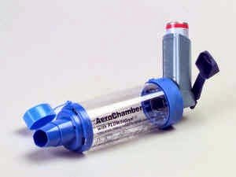
Symptoms Of Asthma
Restlessness
Irritability
Cough
Wheezing
Shortness of breath
Tightness in the chest
Retractions
Speaking in phrases/words instead of sentences
Treatment of asthma includes use of an inhaler. We prefer for students to use a spacer as well, if possible.

Slide 20
LICE
TAKING A CLOSER LOOK
Notes:
No nit policies are NOT recommended by NASN and AAP
Gross factor-but no disease are spread by lice

Slide 21
References
Anderson, K. (2023) Mosby’s textbook for medication assistants, 2nd Ed. Elsevier Inc.
Glucagon Emergency Kit (2022). https://glucagonemergencykit.com/index.php/glucagon-emergency-kit/
Khan, F. (2022). How to store an Epipen. Wikihow. https://www.wikihow.com/Store-an-EpiPen
National Association of School Nurses (October 2021). Medication Administration: Delegation Checklist. Medication Administration Toolkit. www.nasn.org
National Association of School Nurses (October 2021). Model policy: Administering medications to students. Medication Administration Toolkit. www.nasn.org
National Association of School Nurses (October 2021). Model policy: Administering emergency medications to students. Medication Administration Toolkit. www.nasn.org
National Association of School Nurses (2021). School nursing evidence-based clinical practice guidelines: Medication administration in schools. www.nasn.org (2021)

