Slide 1
Tube Feeding with Gtube and Infinity Pump
Amanda Allison, RNC
1/2025

Slide 2
G-Tubes
A G-tube (GT), also referred to as a mic-key or a button, is the most common type of feeding tube.
It is surgically placed through the wall of the abdomen into the stomach and is used to deliver nutrition and medications.

Slide 3
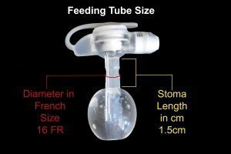
Parts of the GT
B: When safety plug is open, this is where the extension tubing attaches to the GT.
A: Safety Plug: must open prior to feeding and snap closed when finished.
B
A
C
C: Port used to attach a syringe to fill the balloon with. NEVER instill any feeding or medication into this port.
Above Skin
Under Skin
D
D: Balloon that is inflated with sterile water to keep GT in place. The balloon lies beneath the skin.

Slide 4
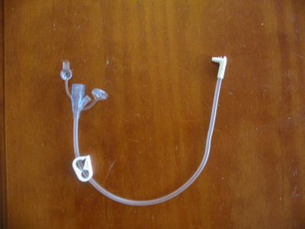
Attaching the extension set
https://www.youtube.com/watch?v=2krLo9ufVhY

Slide 5
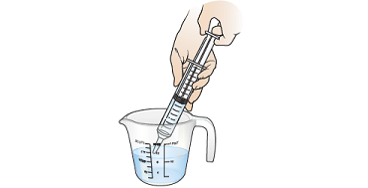
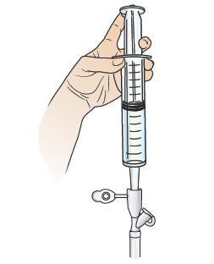
Water Bolus via Syringe
Draw water out of container, avoid air pockets.
Attach syringe to extension set and slowly push plunger to instill water.

Slide 6
Steps to Complete a Bolus
Wash hands
Gather all supplies
Extension tubing, cath tip syringe, container, water.
Position child for feeding, sitting upright in chair, at least 30 degrees head elevation.
Wash hands and put on clean gloves
Attach extension tubing to Gtube
Line up arrow
Snap into place
Twist to lock
Prepare water bolus
Draw up a small amount of water to test patency of extension/Gtube.
If water is hard to push in, stop, do not force it, call nurse/parent.
Draw up water one syringe full at a time
Connect cath tip syringe to extension set, unclamp
Gently and slowly push water in, clamp, disconnect syringe and draw up next syringe full
Repeat this until entire dose of water needed has been given.
When entire dose has been delivered
Disconnect button extension tubing from button
Twist to unlock and disconnect
Close safety plug on button
Remove gloves and wash hands
Place supplies back into backpack
Document as needed
Monitor for tolerance

Slide 7
Signs of Feeding Intolerance
During and after feeding monitor for signs of intolerance such as~
Pain
Nausea
Vomiting
Bloating
Excessive gas
If these occur stop feeding and notify eNurse
If GT becomes dislodged or comes out cover area with a clean gauze pad and call dad immediately. He will need to come to school to attempt to replace GT and if not able student will need medical attention.

Slide 8
References
Feeding Tube Awareness Foundation website. Retrieved from https://www.feedingtubeawareness.org/g-tube/
Any Questions?

Slide 9
Thank You
Your time is greatly appreciated.
© Property of Avel eCare

